Slide 1
Library Management System
Presented by:
Tithir Mahmud Bakshi
Snehashis Ghosh Pial
Afrina Mustofa

Slide 2
Introduction
Library Management System is a small program to manage library which inlcudes the below tasks:
Adding new users, books
Updating users, books
Deleting users, books
Issueing books
Collecting books back
Print interacting reports
Searching for books, users
Keep track of user

Slide 3
Objectives
In this project, our goals are:
To develop a robust system which can store information and manage the everyday transaction of books.
To obtain more accuracy and speed improvement
To handle data inconsistancy
Better error handling capacity
To maintain integrity
To make a user friendly system
Fully handled by admin

Slide 4
Entity Sets
Names of entities are given below:
Admin
Student
Teacher
Book
Issue Book
Report

Slide 5
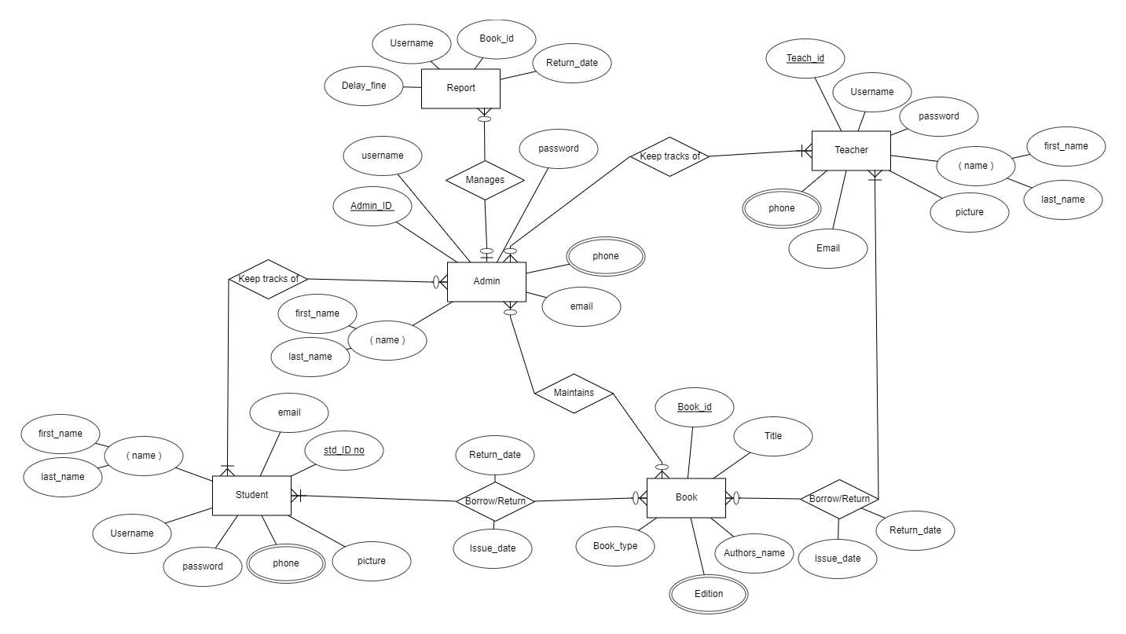
ER-Diagram

Slide 6
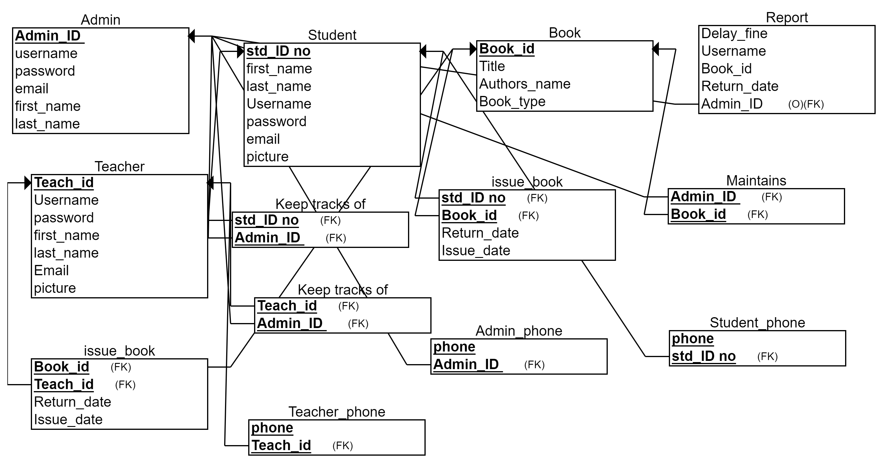
Relational Schema

Slide 7
Relational Schema Modification
Renamed borrow table to Issue Book
Added username collumn to Issue Book and Report table
Made username, mail unique

Slide 8
Insertion Query Sample
Admin
INSERT INTO `admin` (`Admin_ID`, `first_name`, `last_name`, `Username`, `Password`, `email`, `phone`)
VALUES ('2015-2-15-153', 'Md. Tarikul', 'Islam', 'tarikul', 'tarikul1234', 'tarikul@ewubd.edu', '+8801912436712');
Student
INSERT INTO `student` (`Std_ID no`, `first_name`, `last_name`, `Username`, `Password`, `Phone`, `Email`)
VALUES ('2017-2-60-163', 'Snehashis Ghosh', 'Pial', '2017-2-60-163', 'pial1234', '+880-1621619047', 'pialghosh32@gmail.com');

Slide 9
Join Query Sample
Inner Join (to find the information of borrowed books):
Select student.Username, student.first_name, student.last_name,
book.book_id, title, authors_name, edition, issue_date, return_date
from student inner join issue_book
ON student.Username=issue_book.username inner join book
ON issue_book.book_id=book.book_id
where issue_book.approve='Approved’ order by return_date ASC;

Slide 10
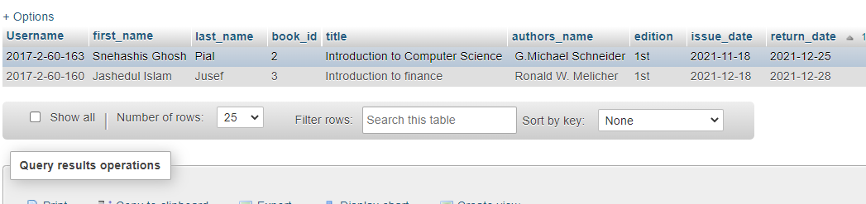
Join Query Sample

Slide 11
Join Query Sample
Natural Join (to calculate the fine for delayed book submission):
with
temp as(select borrower_username,book_id,title,Timestampdiff(day,(select returns_date from report where return_status="EXPIRED"), curdate()) as delay_day
from report natural join book
where return_status="EXPIRED")
select borrower_username,book_id,title,delay_day, delay_day*50 as delay_fine
from temp;

Slide 12
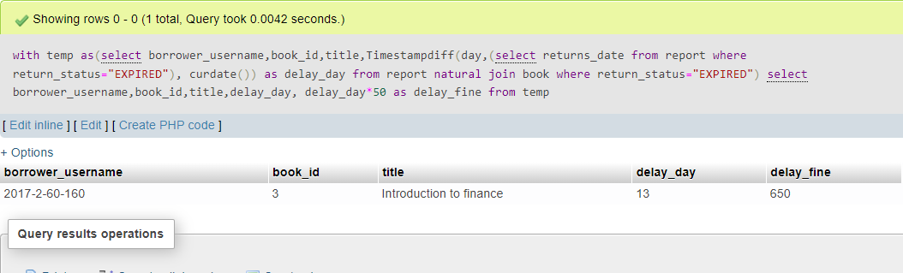
Join Query Sample

Slide 13
Update and Delete Query Sample
To update the not approved request to approve:
update issue_book set approve="Approved",issue_date="2021-12-18",
return_date="2021-12-28"
where username in(select username from issue_book
where username="2016-1-60-095" and book_id=3);

Slide 14
Update and Delete Query Sample
Delete student from the relation who returns the book in due time:
delete from report
where borrower_username not in(select borrower_username
from report
where return_status="EXPIRED");

Slide 15
View and Materialized View
To Hide the confidential information from the user:
create view student_info as
select std_id_no,first_name,last_name,username
from student;

Slide 16
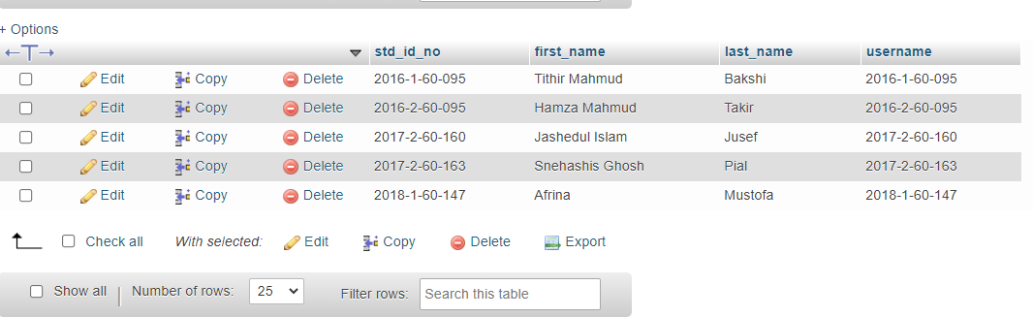
View and Materialized View
Execute: select * from student_info;

Slide 17
View and Materialized View
To Hide admin information:
create MATERIALIZED view admin_info AS
select Admin_id,first_name,last_name,email
from admin;
Execute: select * from admin_info

Slide 18
Conclusion
To conclude, our generated database is user friendly. This system allows storing the details of all data related to library. Admin, student and teacher can interact with each other very easily. We do not develop any interface. For this reason, we can not add different important features like authentication system, communication chat-box, email verification process etc. In future, we will develop a interface using php or python so that we can represent the interaction more graphically. The implement of our database will reduce data entry time and provide readily calculated reports.

Slide 19

Thank you!

